Slide 1
AI 620 EMERGING TOPICS IN ARTIFICIAL INTELLIGENCE
Module 2
Detecting and translation text with amazon rekognition and translate

Slide 2
Learning outcomes
Discuss good design practices and build intelligent capabilities as reusable components.
Go through the process to build end to end text detecting and translating application with Amazon Rekognition and Translate.

Slide 3
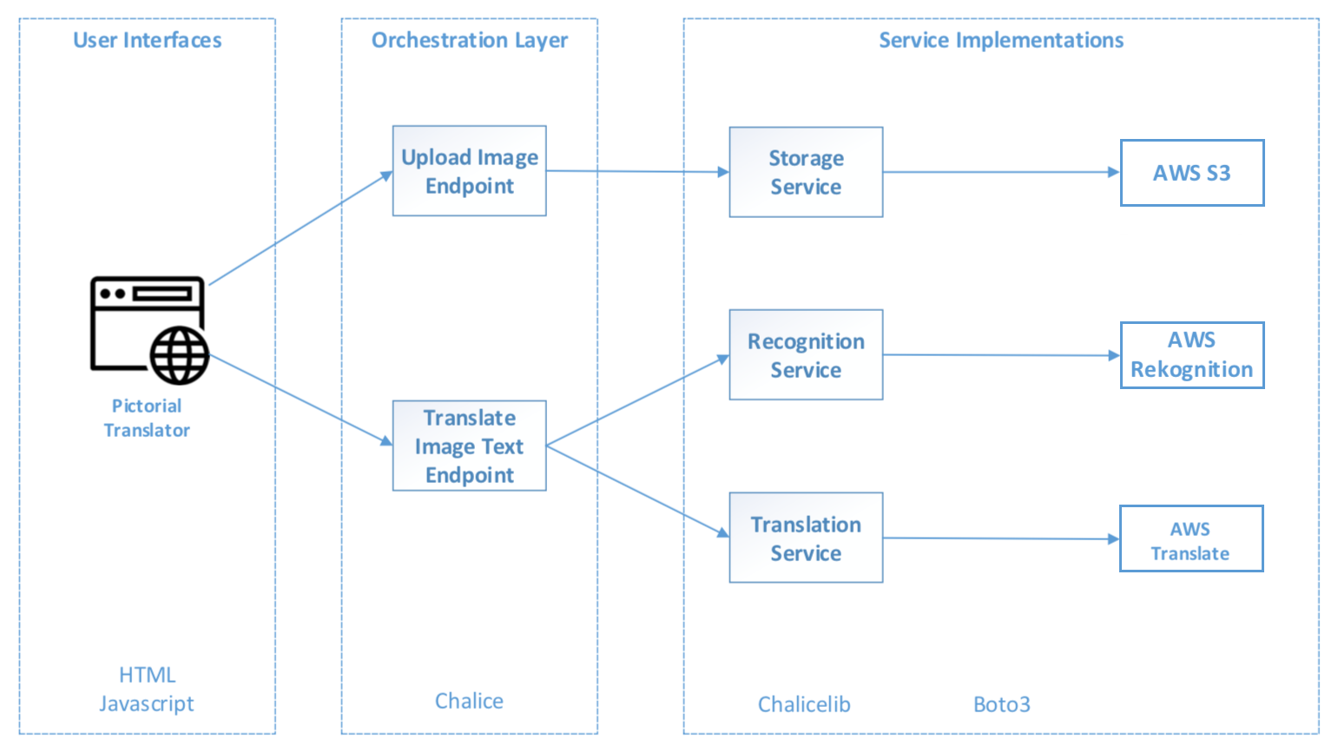
The architecture of pictorial translator

Slide 4
THE ARCHITECTURE OF PICTORIAL TRANSLATOR
We will provide a web user interface for users to upload photos containing foreign text and then view the translation of the foreign text.
The web user interface will interact with the Orchestration Layer containing two RESTful endpoints to handle the image upload and translation.

Slide 5
THE ARCHITECTURE OF PICTORIAL TRANSLATOR
Upload Image Endpoint
Delegate the image upload to S3
Translate Image Text Endpoint
Delegate the detection of text within the photos to the Recognition Service
And the translation of the detected text to Translation Service

Slide 6
THE ARCHITECTURE OF PICTORIAL TRANSLATOR
The Recognition Service provides an abstraction layer to the Amazon Rekognition service which is named as Recognition, which is more generic and doesn't directly tie with AWS Rekognition.
The Translation Service provides an abstraction layer to the Amazon Translate service to perform the language translation.

Slide 7
WHy Two type of services?
Easily to build and test the application.
Easily switch to services with better storage, recognition, or translation capabilities.
Codes are more composable an reusable.

Slide 8
Component interactions of pictorial translator
It's important to think through how the components of an application interact with each other
AND how the user experience will be influenced by our design choices before we dive into the implementation

Slide 9
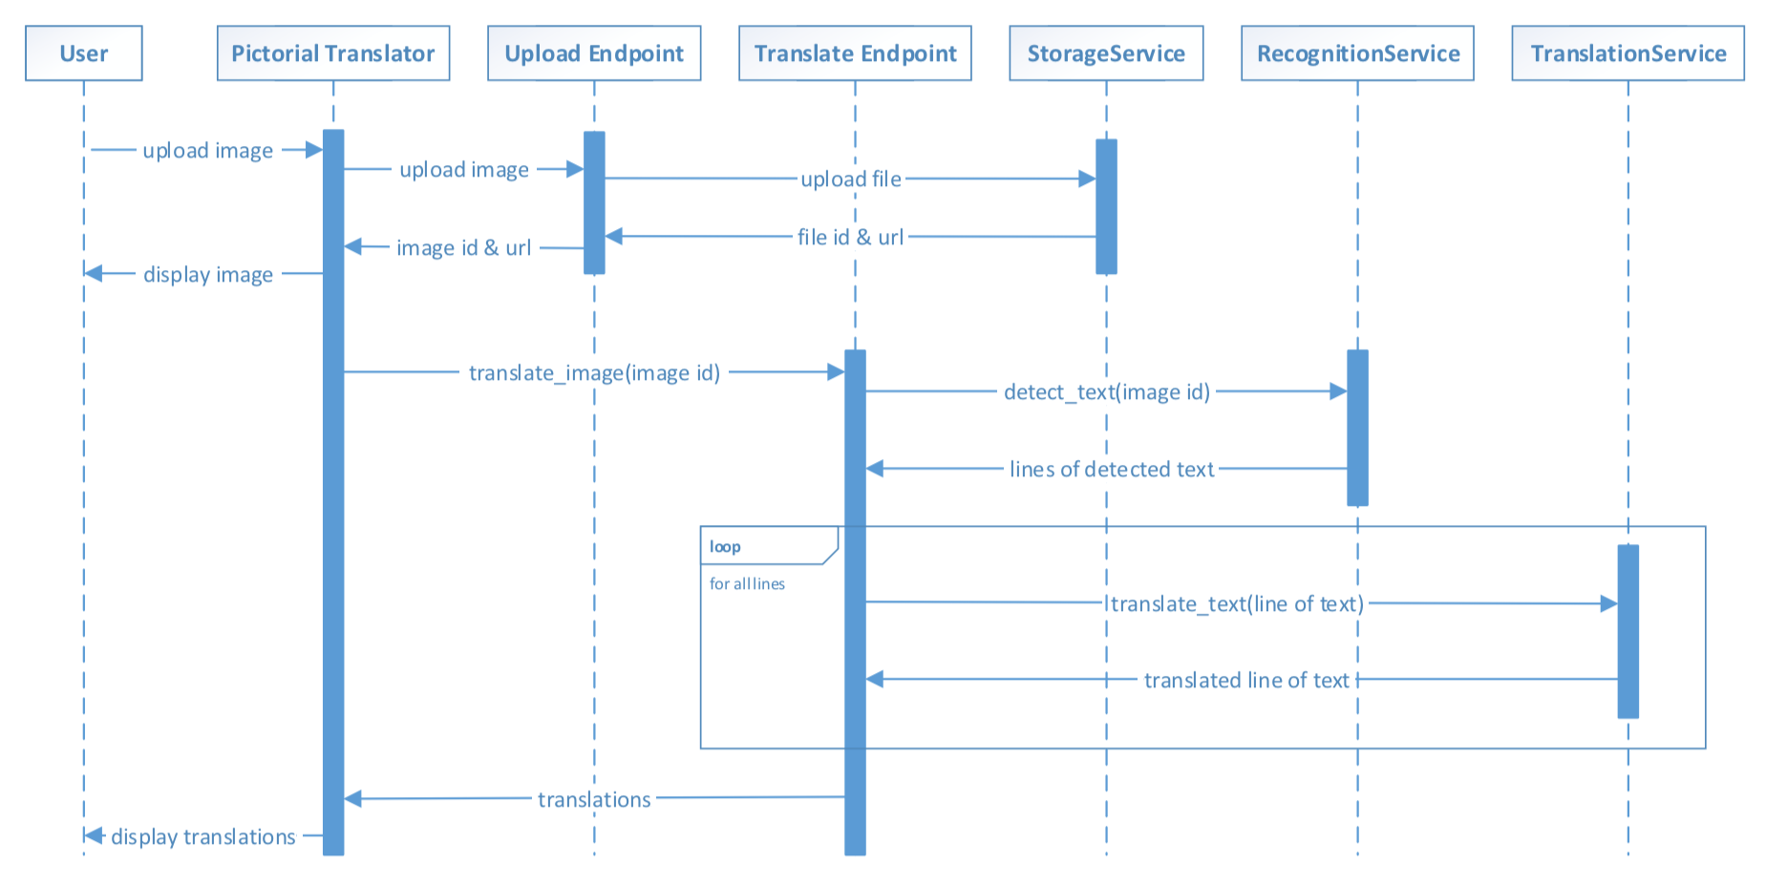
COMPONENT INTERACTIONS OF PICTORIAL TRANSLATOR

Slide 10
COMPONENT INTERACTIONS OF PICTORIAL TRANSLATOR
The application provides a sequential experience for uploading the image, viewing the uploaded images, and seeing the translated text.
We made the design decision to ensure the user waits for each photo to be uploaded and processed.
The design decision is fine given we assume that the users are at the physical locations waiting to see the translations before making decisions or taking actions.

Slide 11
Interaction with Upload Image endpoint and Storage Service
The users' requests are essentially passed through to AWS S3 and back in a chain.
The photos will be stored in an S3 bucket, and the text detection and translation will be performed from the S3 bucket.

Slide 12
The Translate image text endpoint
It does a couple of things behind the scenes
Is calling detect_text() in RecognitionService on the entire image,
And then calling translate_text() in Translation Service multiple times for the lines of detected text
The endpoint will only call the Translation Service if the detected line of text meets a minimum confidence threshold

Slide 13
Two design decisions
Translate text at the line level
In the real world the text we see is not always in the same context (for example, multiple street signs in the same photo).
Only translate a line of text that RecognitionService is very confident about
The user might upload photos containing text that's not relevant to the translation task (for example, street signs in a distance), or the user might upload photos not fit for quality text detection (for example, poor lighting and bad focus).

Slide 14
Implementing the project
PE02-1
Setting up the project structure
Follow textbook page 96 step 1 to 6
PE02-2 Implementing services
2.1 Recognition service – text detection
2.2 Translation service – translating text
2.3 Storage service – uploading files

Slide 15
About 2.1 rekognition text detection
It seems to work well with alphabet-based languages such as English, German, and French, but doesn't work as well with character-based languages such as Chinese, Korean, and Japanese.
This definitely limits the use cases of the application.

Slide 16
ABOUT 2.2 Translation service
Amazon Translate service supports the concept of custom terminology.
This feature allows developers to set up custom terminology to use during translation.
This is useful for use cases where words and phrases in the source text are not part of the standard language such as company names, brands, and products.

Slide 17
IMPLEMENTING THE PROJECT
PE02-3 Implementing RESTful endpoints
Part of the orchestration layer with the RESTful endpoints
3.1 Translate the image text endpoint
3.2 Upload the image endpoint
PE02-4 Implementing the web user interface
Index.html + scripts.js
PE02-5 Deploying Pictorial Translator to AWS
DONE!

Slide 18
References
Tripuraneni, S., & Song, C. (2019). Hands-On Artificial Intelligence on Amazon Web Services. Packt Publishing. https://learning.oreilly.com/library/view/hands-on-artificial-intelligence/9781789534146/

